Slide 1
Collective Magnetism in Long-Range
Ordered Structures of Magnetic Nanoparticles
PhD Defense | Disch Group | Department of Chemistry | Dominique Dresen | 25.03.2019

Slide 2
Introduction
Nanotechnology presents great potential for breakthroughs in
medicine, energy production/storage, electronics & information technology
Self-assembly of nanoparticles to fabricate nanostructured devices
being precise, flexible in material choice & having a low production cost
Magnetic nanoparticles, e.g. for bit-patterned high-density magnetic recording media
→ requires understanding of interparticle interaction
[1] ABC
1

Slide 3
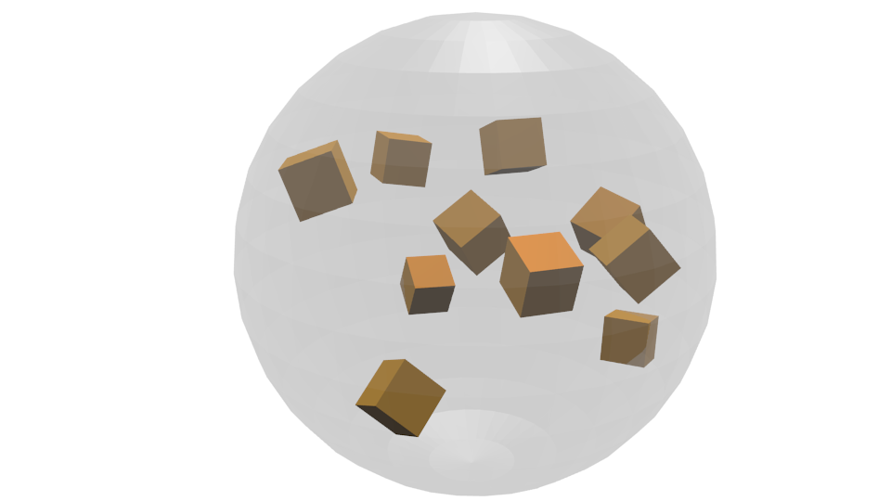
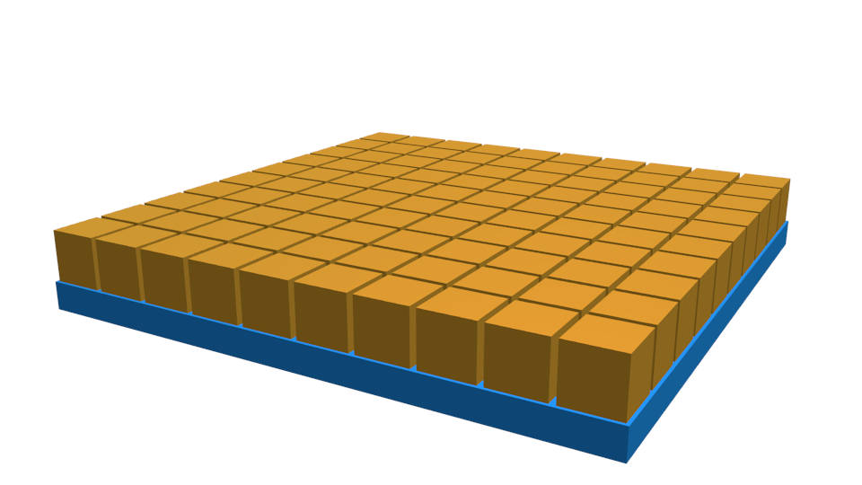
Concept
Individual NP Properties
Collective Properties
[1] L. Wu, P. O. Jubert, S. Sun et al., Nano Letters, 2014, 14, (6), 3395-3399.
1

Slide 4
Model Systems
[1] L. Wu, P. O. Jubert, S. Sun et al., Nano Letters, 2014, 14, (6), 3395-3399.
1

Slide 5
Nanoparticle Synthesis
test
[1] F. Ott, A. Menelle, , P. D. I. E. Condens, et al., Reﬂectometry, 1999, pp 163–195.
[2] Heinz Maier-Leibnitz Zentrum, Journal of large-scale research facilities, 2015, 1, 1–3.
6

Slide 6
Nanoparticle Structural Characterization
[1] C. Pecharromán, T. Gonzalez-Carreno, J. E. Iglesias, Physics and Chemistry of Minerals, 1995, 22, 21–29.
[2] J. Park, K. An, Y. Hwang, et al. Nature Materials 2004, 3, 891–895.
4

Slide 7
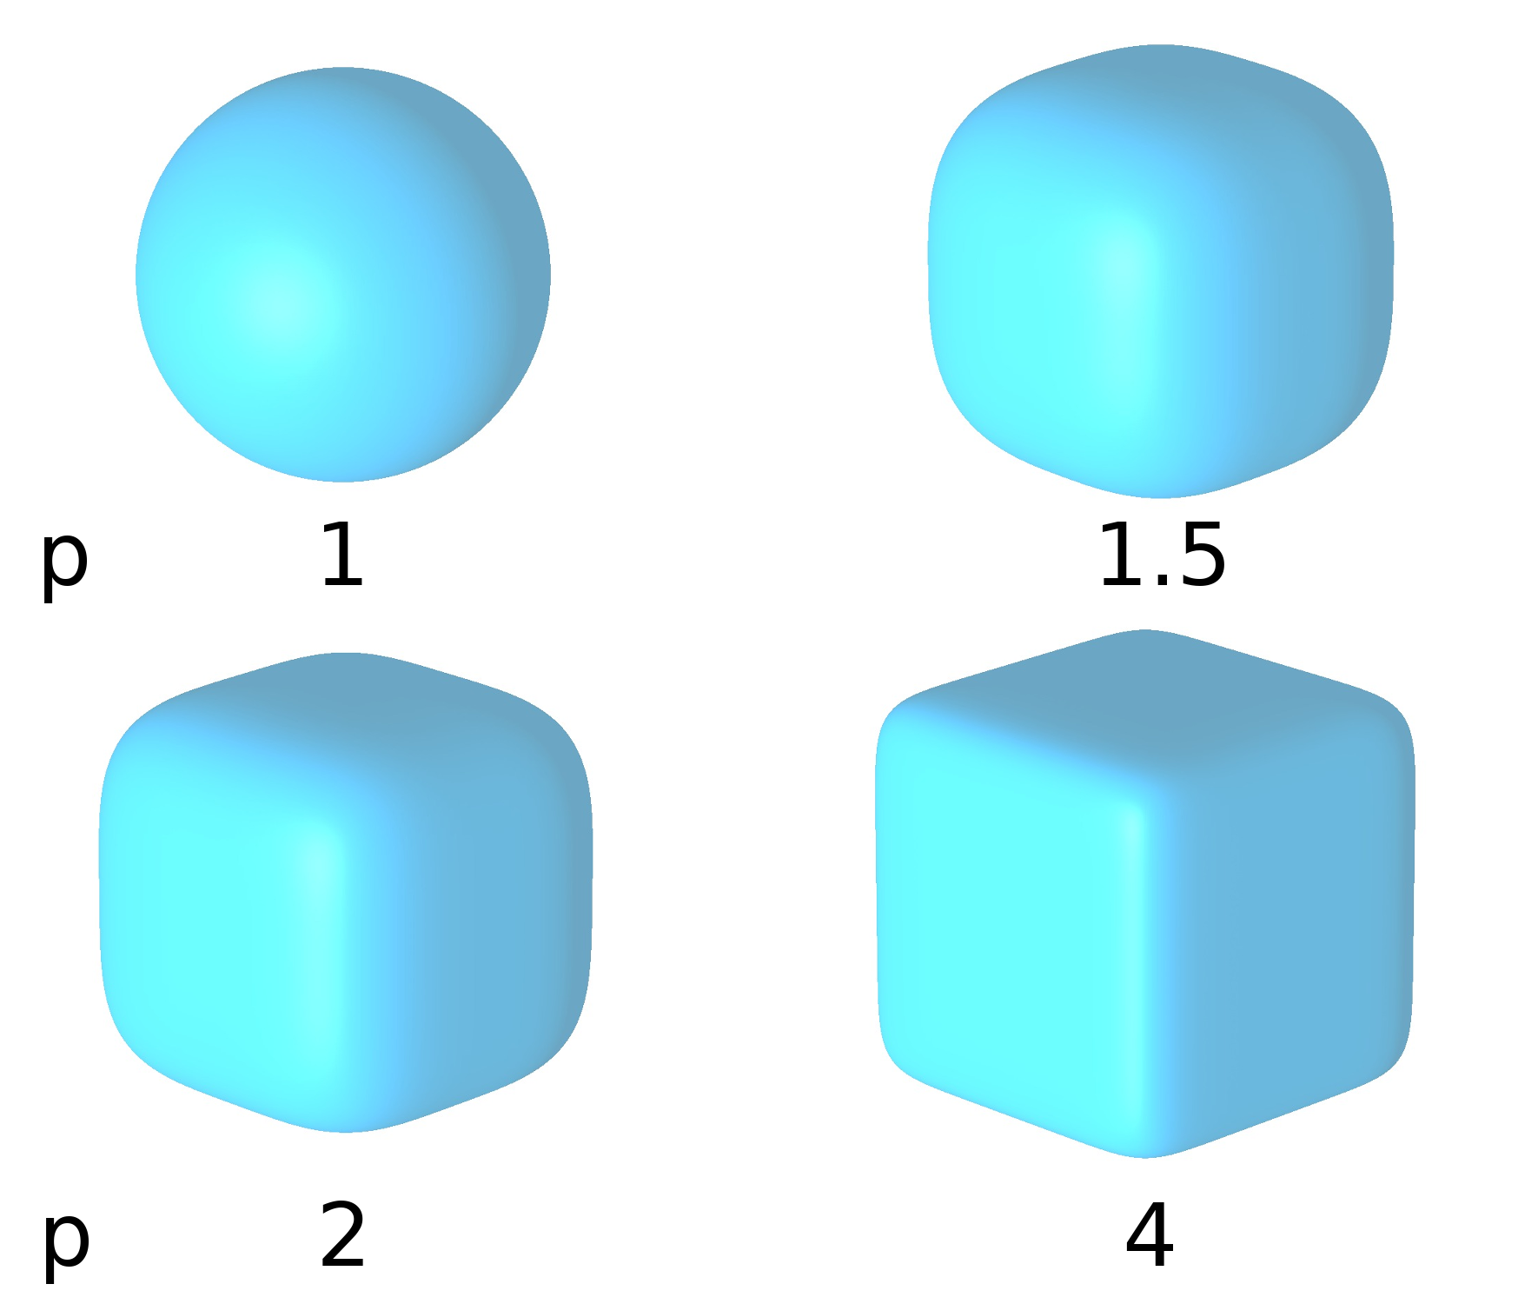
Superball Form Factor
[1] C. Pecharromán, T. Gonzalez-Carreno, J. E. Iglesias, Physics and Chemistry of Minerals, 1995, 22, 21–29.
[2] J. Park, K. An, Y. Hwang, et al. Nature Materials 2004, 3, 891–895.
4

Slide 8
Individual Nanoparticle Magnetism
Text
[1] Sources
6

Slide 9
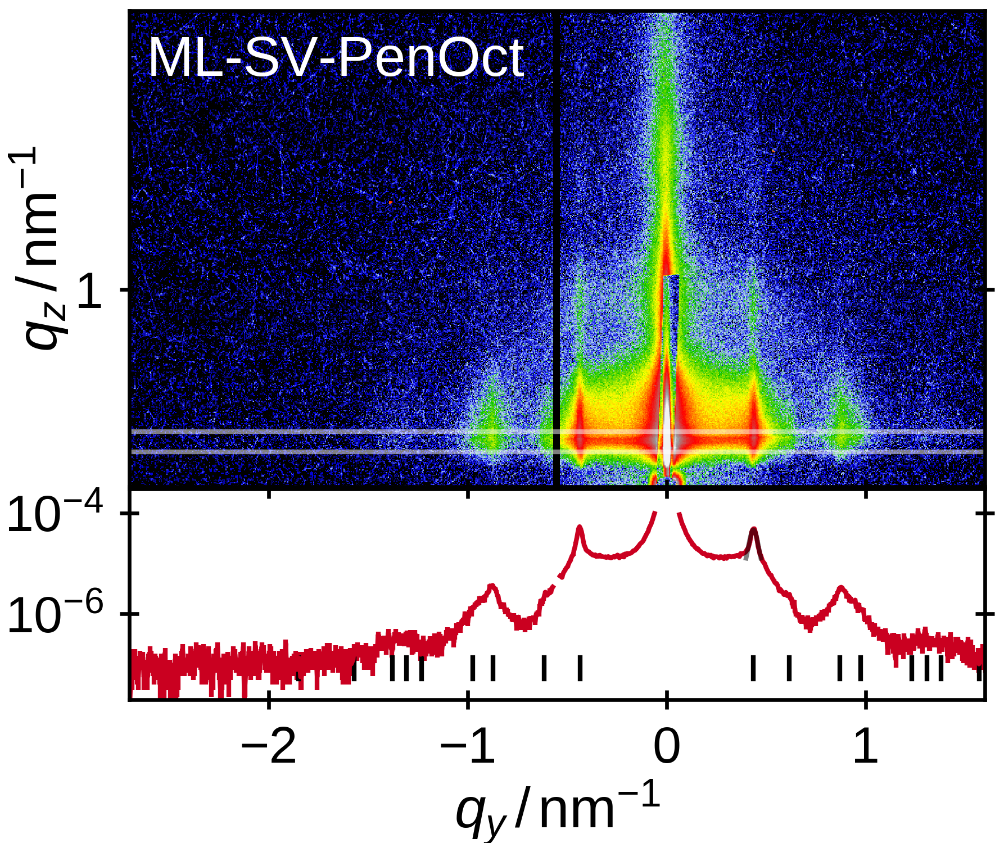
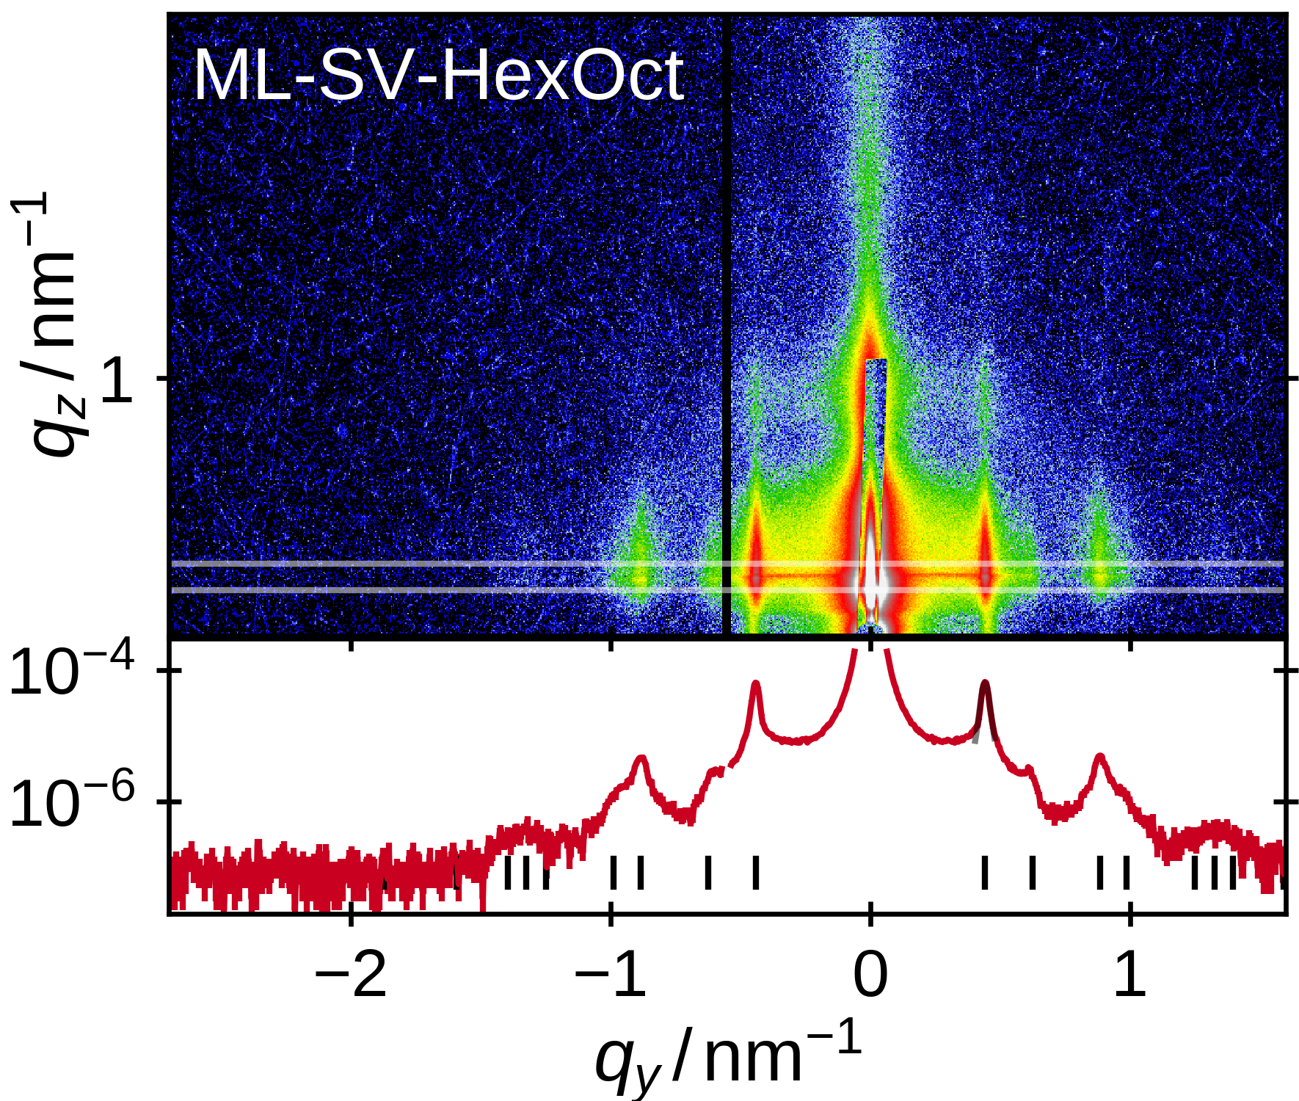
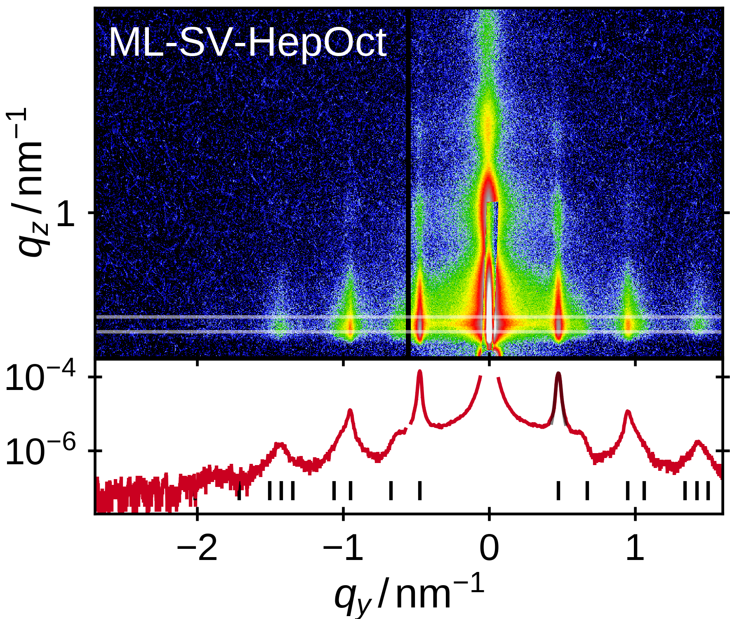
Self-Assembly of Long-Range Ordered Monolayers
Text
[1] Sources
6

Slide 10
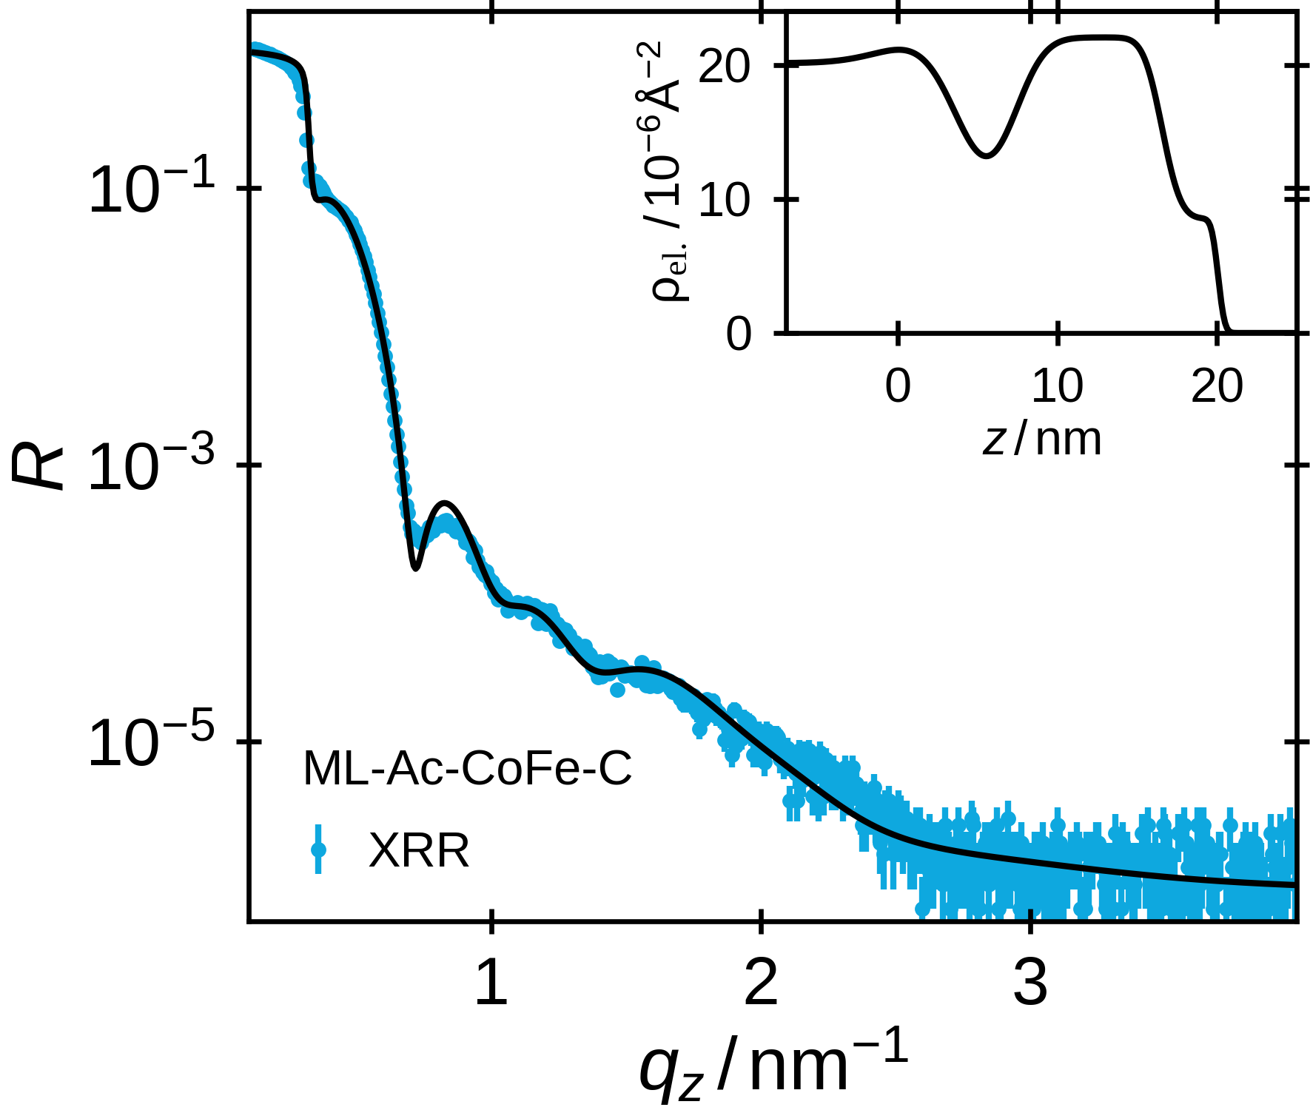
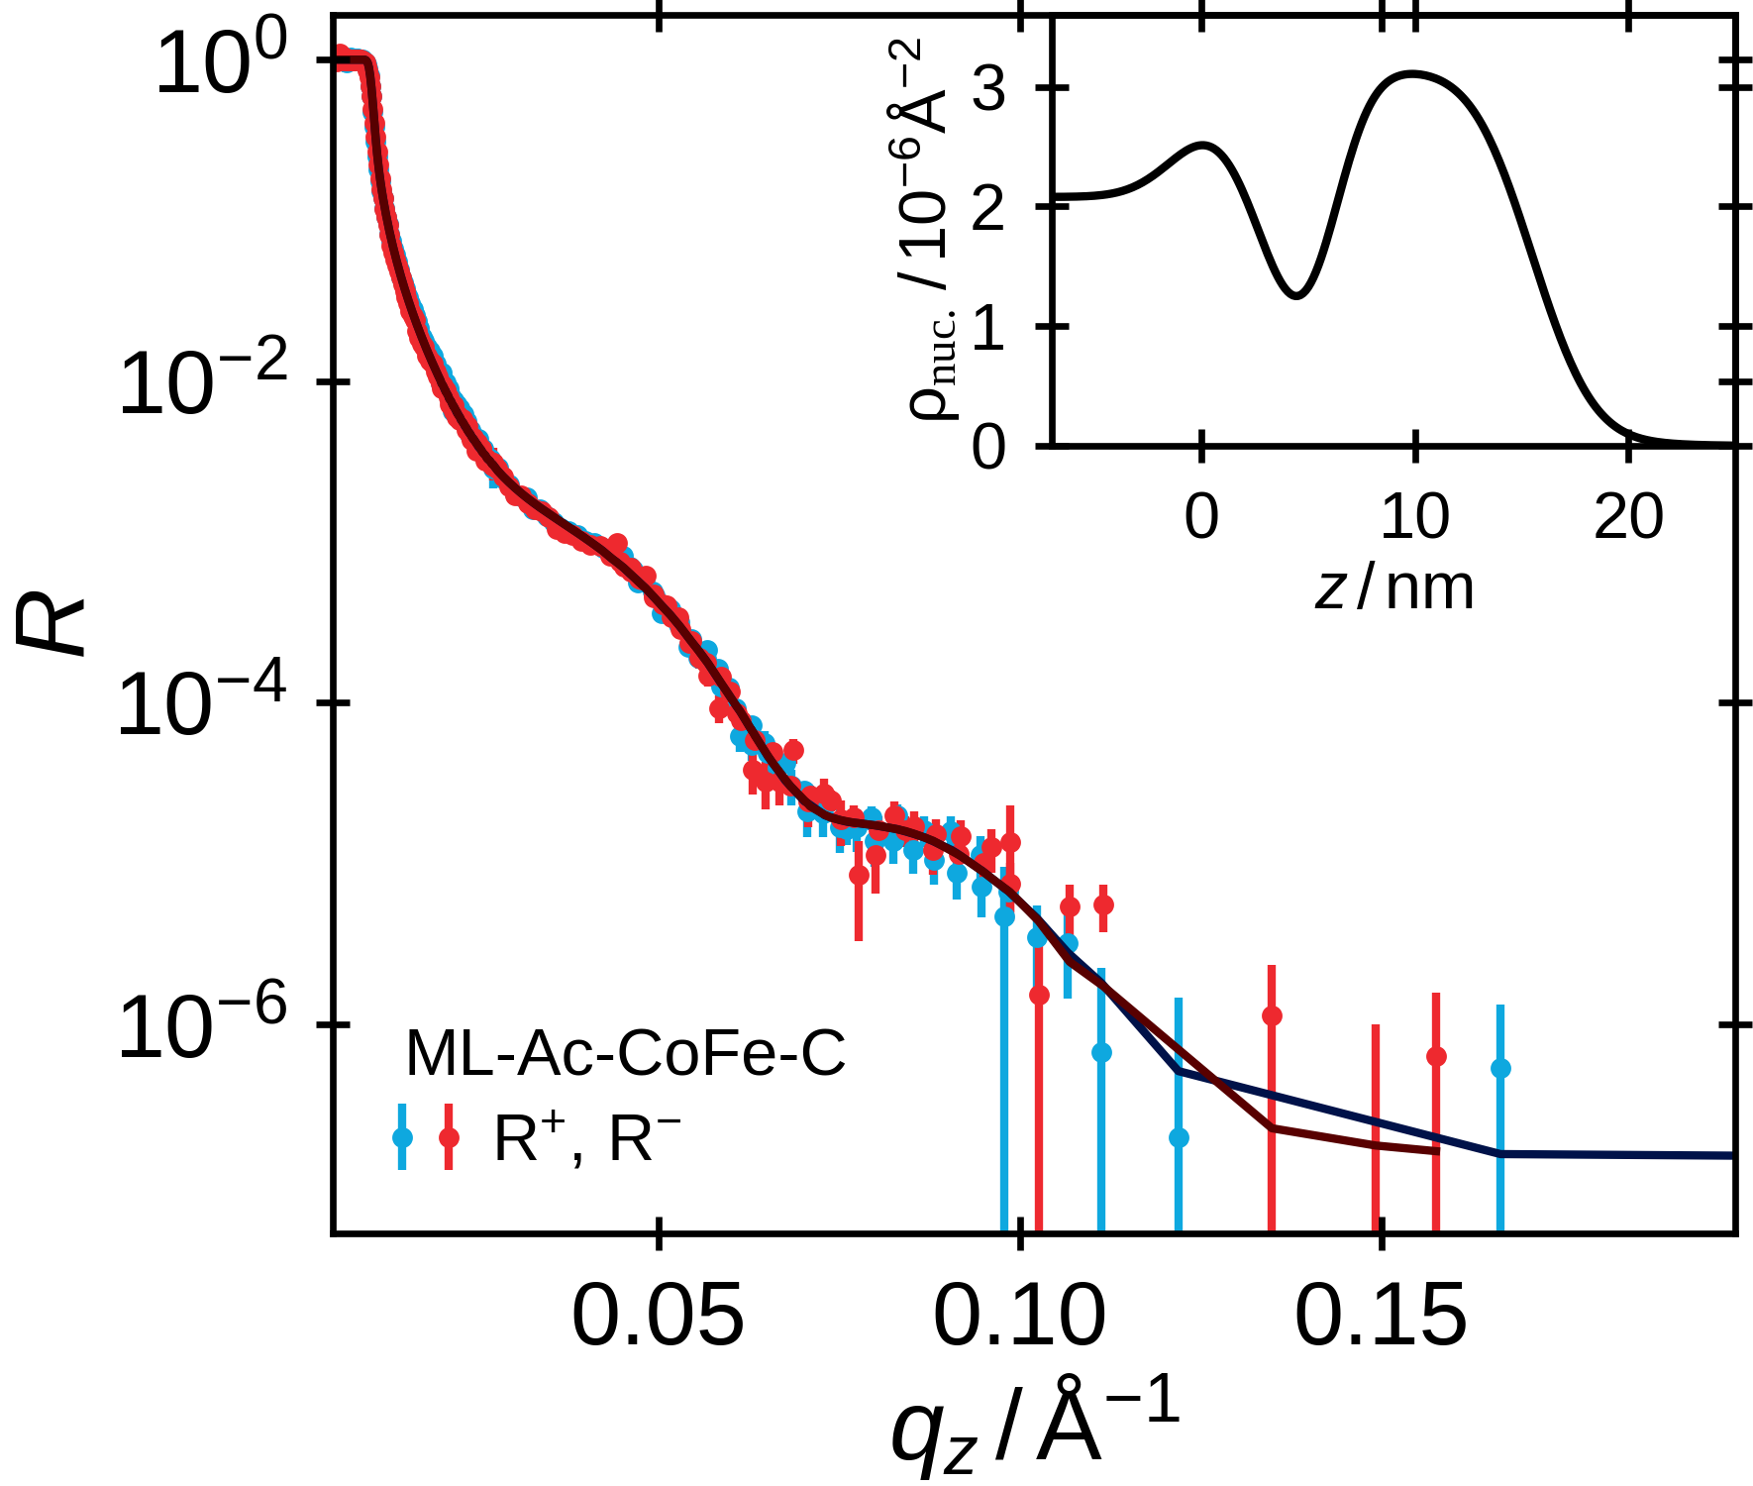
Vertical Structure
Text
[1] Sources
6

Slide 11
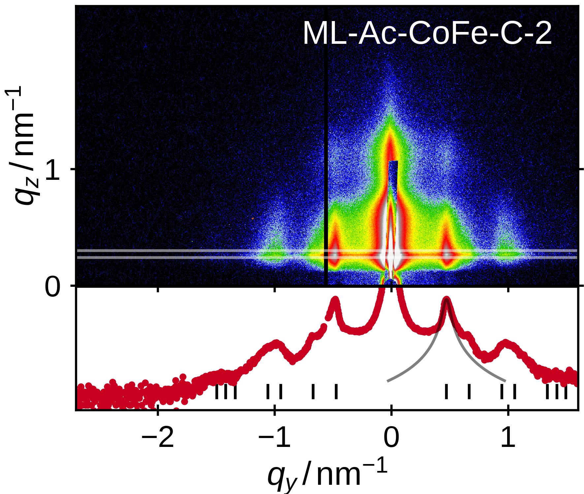
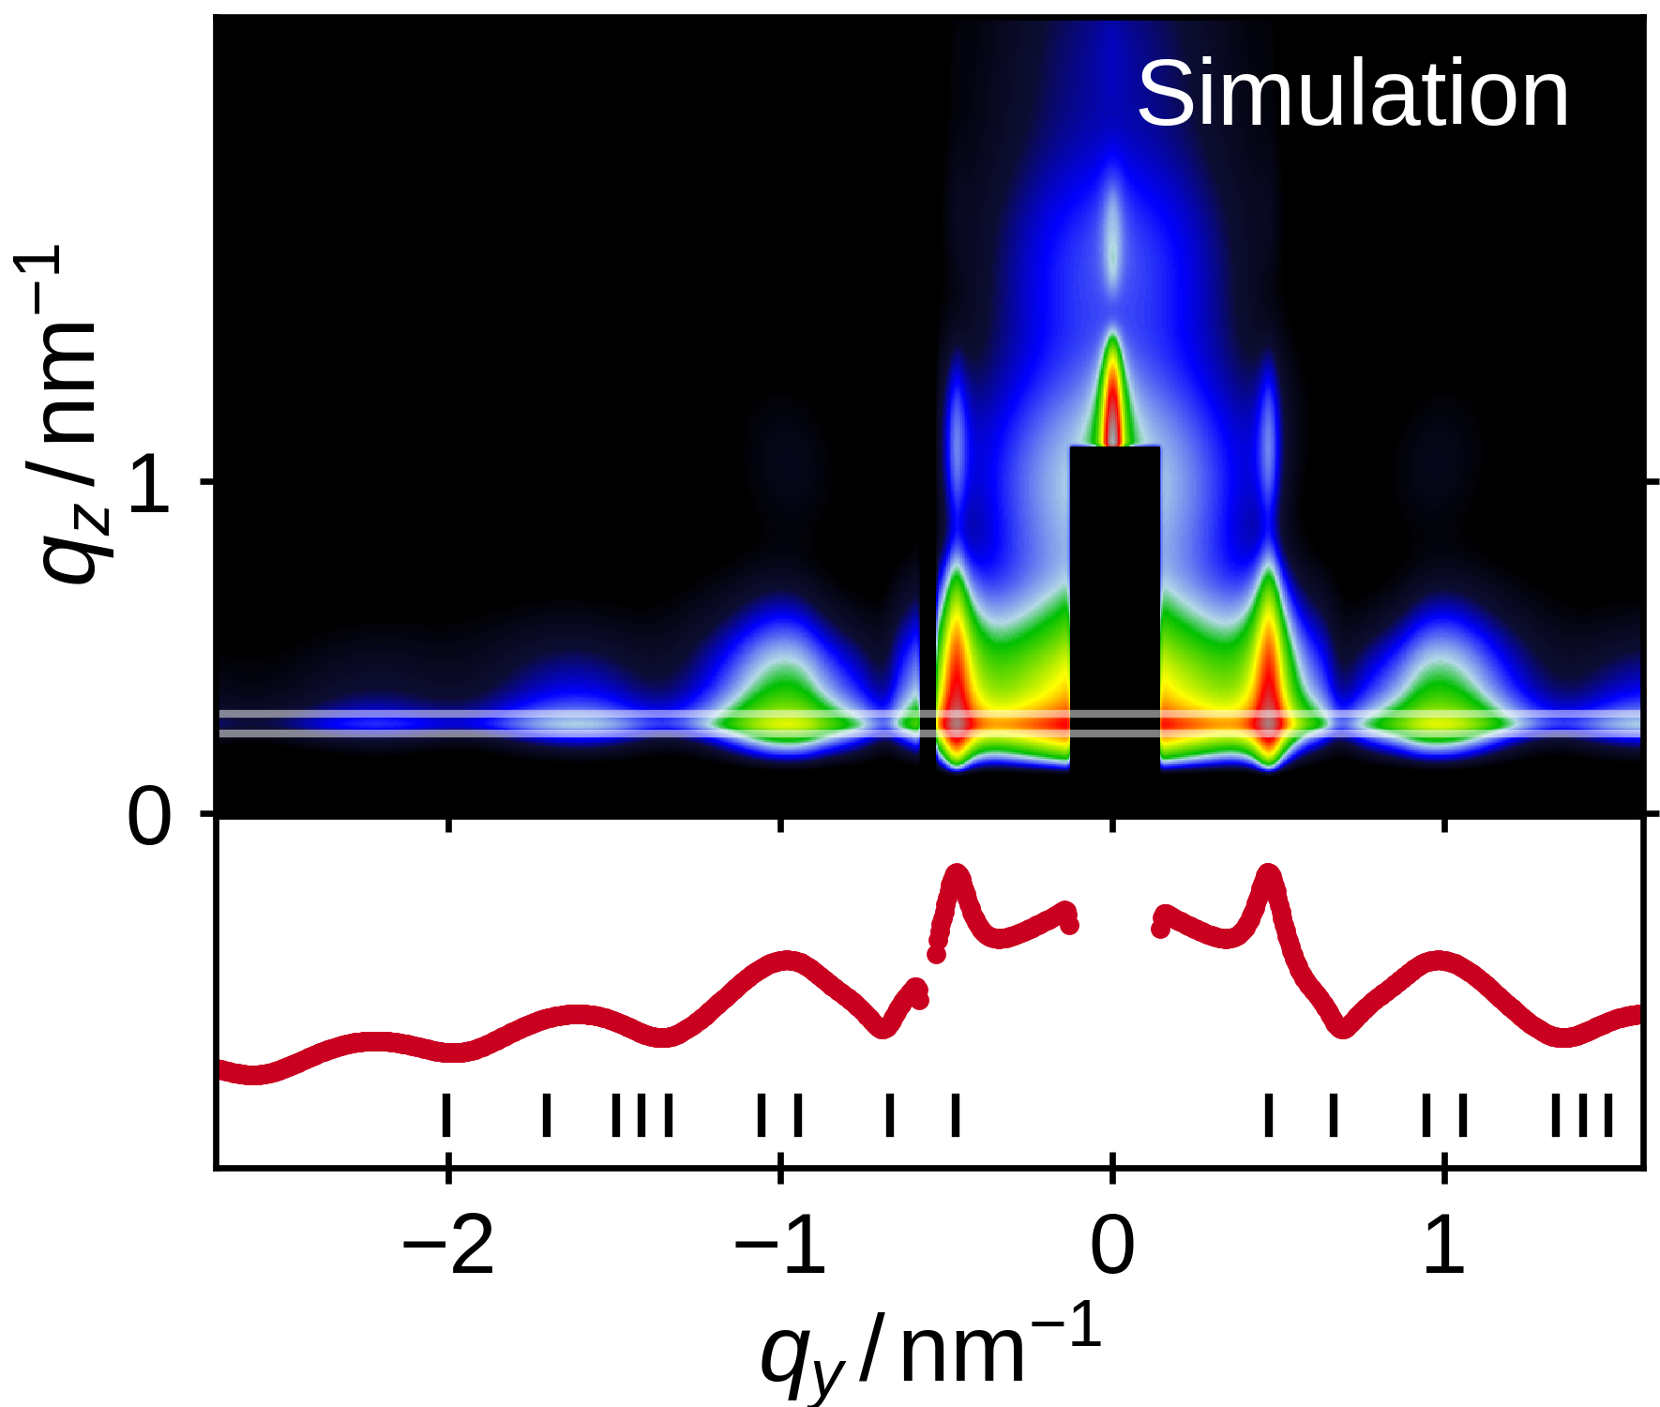
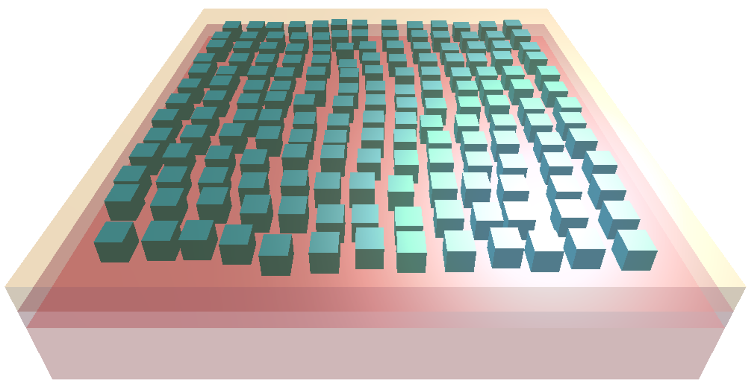
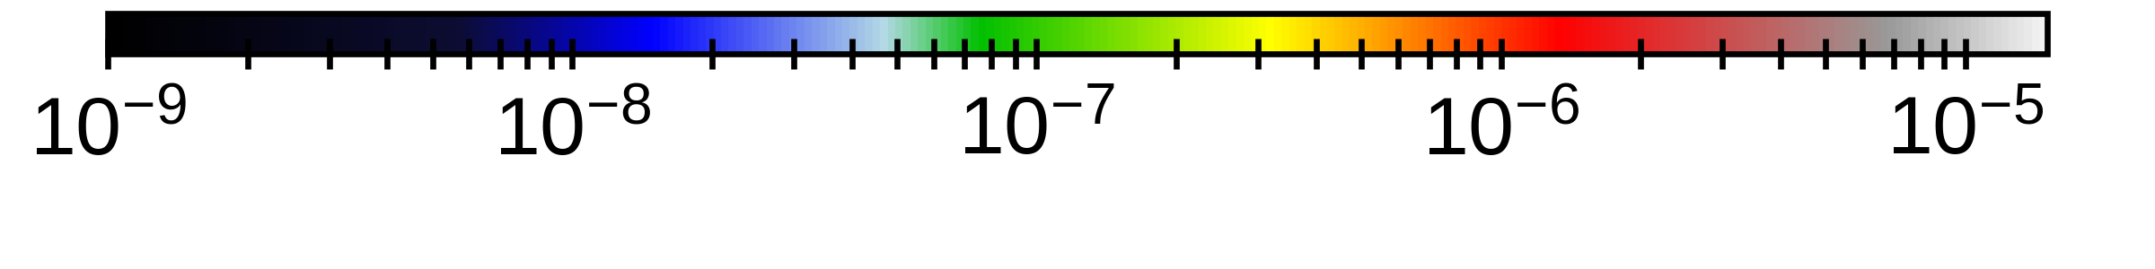
Quantitative Evaluation of Lateral Order
Text
[1] Sources
6

Slide 12
Magnetism in a Monolayer
Text
[1] Sources
6

Slide 13
Extension to Double Layers
Text
[1] Sources
6

Slide 14
Search for Dipolar Interlayer Coupling
Text
[1] Sources
6

Slide 15
Title
Text
[1] Sources
6

Slide 16
Title
Text
[1] Sources
6

Slide 17
Title
Text
[1] Sources
6

Slide 18
Summary
Text
[1] Sources
6

Slide 19
Outlook
Text
[1] Sources
6

Slide 20
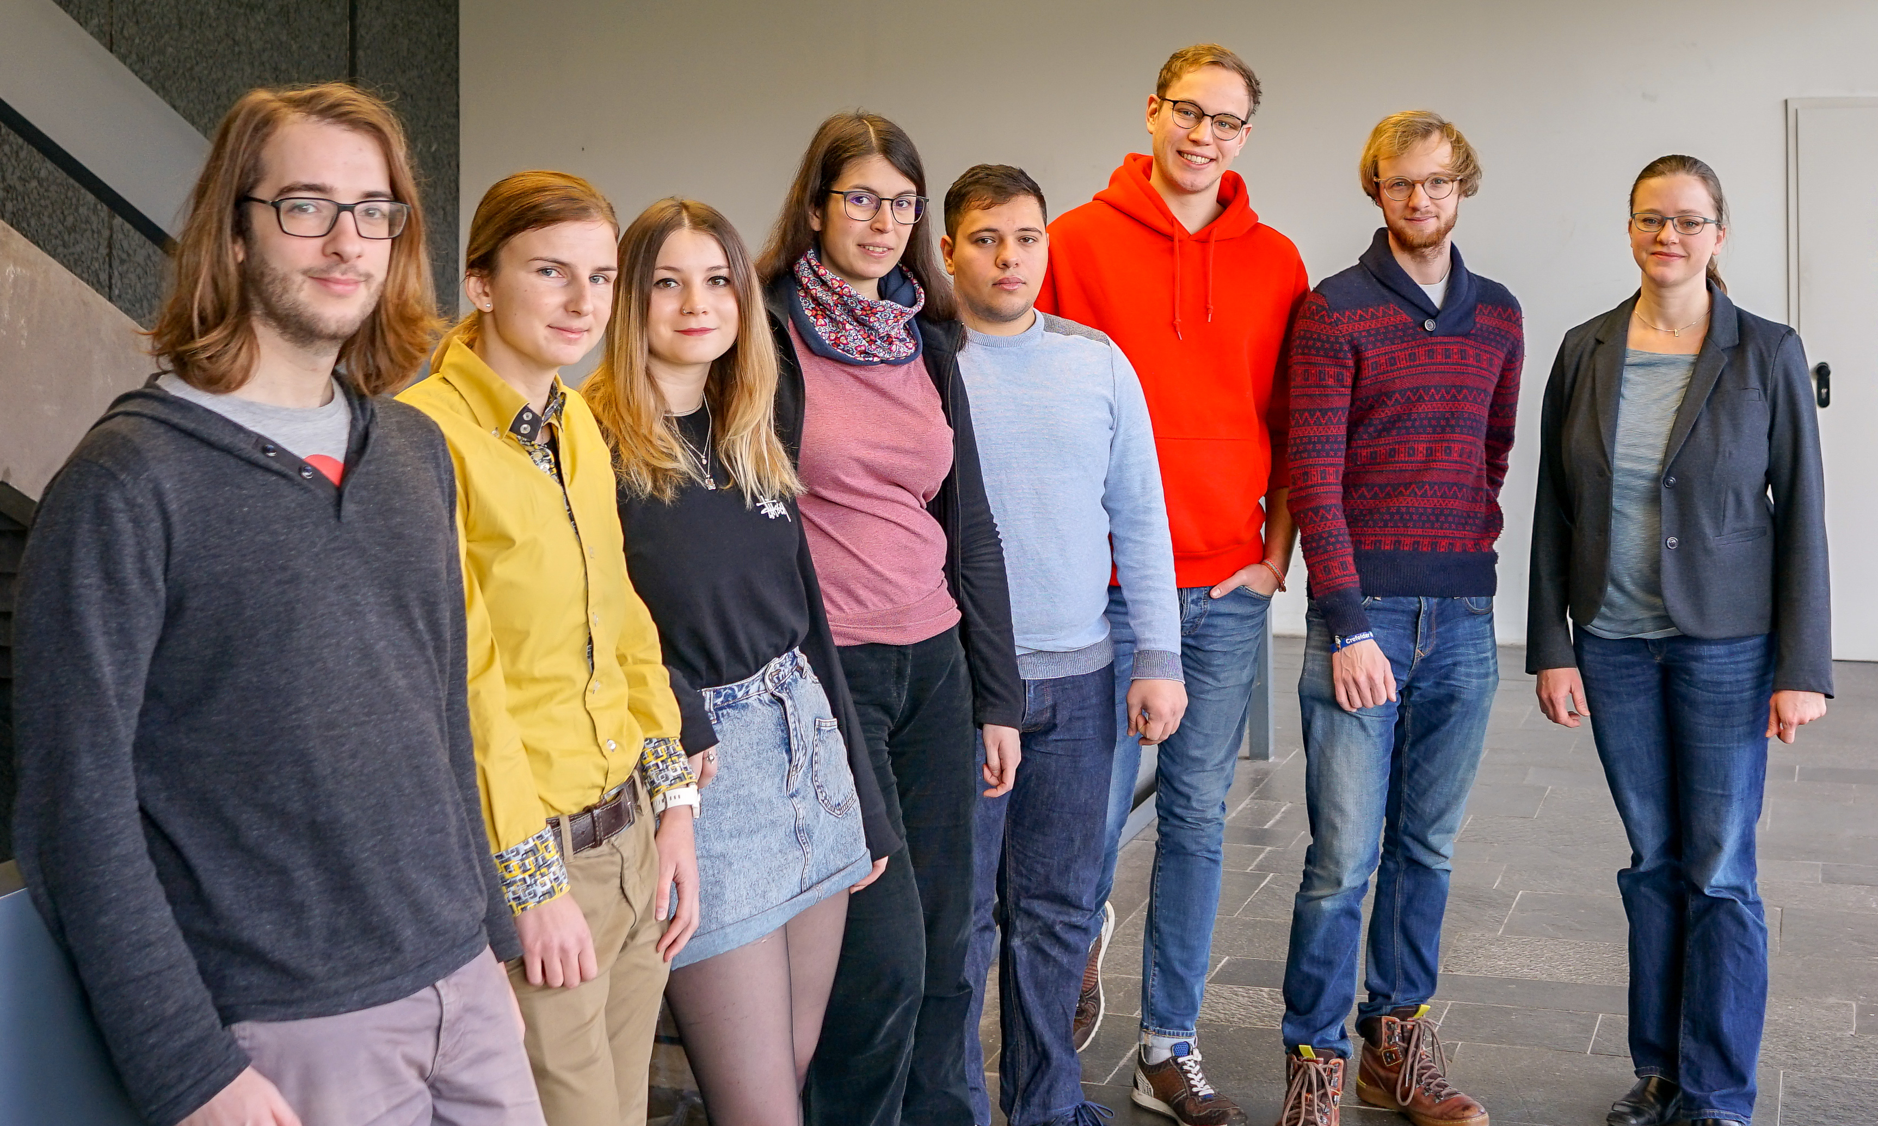





Acknowledgements
Dr. Sabrina Disch
Prof. Dr. Sanjay Mathur
Prof Dr. Uwe Ruschewitz
Dr. Stefan Roitsch
Maria Hentschel
Flore Mees
Dominika Zàkutnà
Yannic Falke
Daniel Stadler
Ali Al Mawlar
Kevin Graeff
Prof. Dr. Annette Schmidt
& her workgroup
Dr. Emmanuel Kentzinger
Dr. Dirk Honecker
Dr. Thomas Saerbeck
Dr. Alexei Vorobiev
Dr. Gunnar Pálsson
Dr. Anton Devishvili
Dr. Stefan Mattauch
Dr. Alexandros Koutsioumpas
Christian Tobeck
Markus Krüger
Rajitha Ravithas
Anne Hansen
Prof. Dr. Wolfgang Tremel
Dr. Kristina Wichmann
Eugen Schechtel
Viktor Klippert & the workshop
Verband der Chemischen Industrie
14

